Slide 1
Business Cases with Data Science
2019-2020 Nuno António
Business Case:
Predict Hotel Booking Cancellations
Palm & Company
Pedro Santos (M20190420)
Ana Cláudia Alferes (M20190932)
Lennart Dangers (M20190251)
Michael Machatschek (M20190054)

Slide 2




Current Situation and Problems
Palm & Company
Demand-driven Market
Hospitality is a customer market with high competition.
41.7 %
Cancellation Rate
The Power of OTA’s
Online Travel Agencies, such as booking.com, have a high impact on hotels.
Cancellations
Due to flexible cancellation policies, customers cancel after finding a better deal (“deal-seekers”).
Overbooking
To avoid empty rooms, hotels tend to overbook their capacity. This can cause reallocation cost and reputation damage.

Slide 3




Benefits of a data-driven solution
Palm & Company
Why should you implement a data-driven solution?
Success criteria
Less lost sales
Predict cancellations, avoid empty rooms, stick to flexible cancellation policy
Accuracy:
above 80 %
Improve Revenue Management
Adjust your pricing strategy to the actual net demand.
Avoid costs of reallocation and reputational damage
20 % decrease in cancellation rate
Due to a more precise net demand prediction, less reallocations are needed
and no reputational damage occurs.
Improve Customer Relationship Management
Gain knowledge about patterns of your customers and avoid cancellation
by introducing special offers.

Slide 4
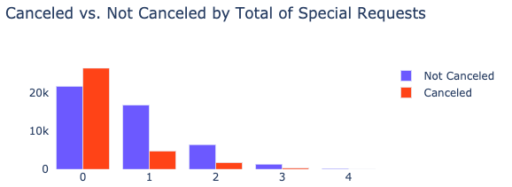
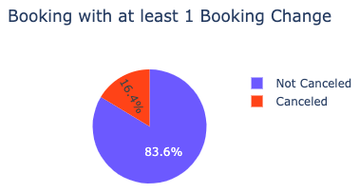
Active and demanding guests are less likely to cancel
Palm & Company
Cancelled VS. Not Cancelled by Total of Special Requests
Booking with at least 1 booking change
Customers that don’t make special requests are more likely to cancel bookings.
Customers that have made changes in their booking, usually don’t cancel their reservation.

Slide 5
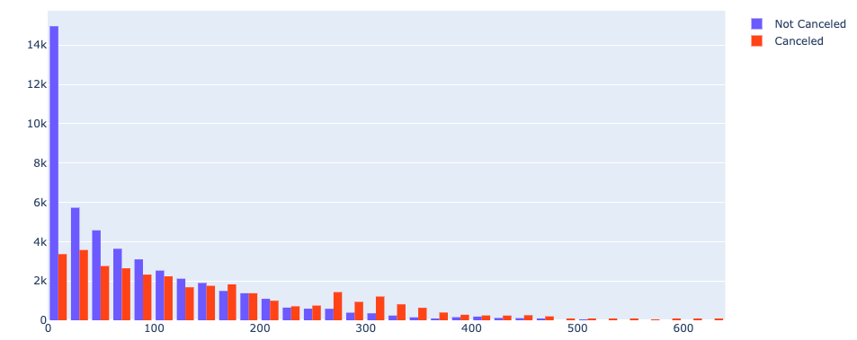
Spontaneous bookings are less often cancelled
Palm & Company
Lead Time in Cancelled and Not Cancelled Bookings
A higher lead time means an increasing rate of cancellation.

Slide 6
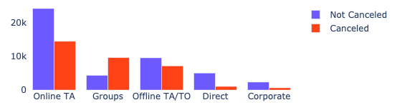
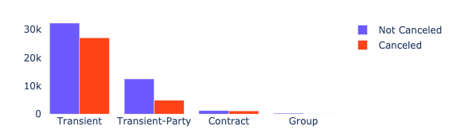
There are customer segments with more cancelled bookings
Palm & Company
Cancelled VS. Not Cancelled by Market Segment
Cancelled VS. Not Cancelled by Customer Type
The market segment corresponding to “Groups” has a great impact in the cancelled bookings.
In ”Transient” and “Contract” customers types there is a higher rate of cancellation.

Slide 7
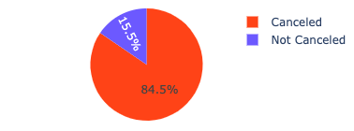
Customers do not only cancel once
Palm & Company
Customers that previously cancelled
People that have cancelled reservations in the past show an 84% chance to cancel again

Slide 8
Modelling Methodology
01
First iteration
Five algorithms were tested with two feature sets.
5 Algorithms
2 Feature sets
02
Second iteration
The two best semi-tuned algorithms of I1 were tested with several variants of the best performing feature set of I1.
2 Algorithms
1 Feature set
03
Fine-tuning
The best performing algorithm was fine-tuned with the best performing feature set variant of I2.
Fine-tuned
model

Slide 9
First Iteration
LOGISTIC REGRESSION
18 variants
Feature Set 1
Nearly all available features with continuous variables binned and one-hot-encoded
Evaluation
RANDOM FOREST
24 variants
Random Forest
XGBoost
+
MULTI LAYER PERCEPTRON
27 variants
GRADIENT TREE BOOSTING
36 variants
Feature Set 2
Nearly all available features with continuous variables kept continuous
XGBOOST
54 variants

Slide 10
Second Iteration
Evaluation
XGBoost
+
All features
with LeadTimeLog
RANDOM FOREST
12 variants
Feature Set 2
→ Log and sqrt transformation
Omitting less important
features
XGBOOST
8 variants

Slide 11
Fine tuning
XGBOOST
Hyperparameter
Tuning with Optuna
Feature Set 2
85.11%
85.94%
76,51%
80.95%
Accuracy
Precision
Recall
F1

Slide 12
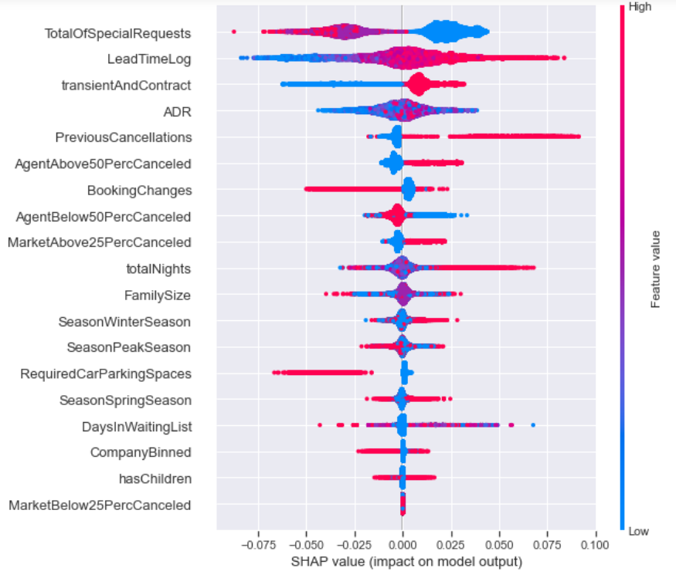
What makes a guest more likely to cancel?
Guests with many special requests are less likely to cancel
A longer lead time increases the likelihood of cancellation
Transient and contract booking have a high probability of cancellation
Short stays are less likely to be cancelled than long stays
Guests that require car parking spaces are less likely to cancel

Slide 13


Deployment & Maintenance Strategy
Palm & Company
Deployment
Maintenance
Connecting to existing enterprise resource planning system avoids manual work
Allows real-time prediction of cancellation per booking
Real-time net demand
New training after large amounts of new data is collected
Short validation cycles after deployment to ensure model is correctly predicting cancellations

Slide 14




Future improvements
Palm & Company
Data Constraints
Time Constraints
More Data
The use of a new datasets allows us to train the model with more data.
Additional Features
Additional features could also improve the model results. In particular, the readjustment of the Deposit Type feature.
Different Models
The testing of different models could provide better results.
Additional Transformations and Hyperparameter Tuning
The testing of new transformations and other hyperparameter tuning could translate to better results.

Slide 15




Iterative Process
Conclusion
Predict Hotel Booking Cancellations
Satisfying solution for cancellation problem
Palm & Company
Great Explainability
Future Improvements

Slide 16
Thank you!
Any questions?
Palm & Company

